Slide 1

SOFTWARE ENGINEERING concept

Slide 2

INTRODUCTION
Software engineering
is a detailed study of
Engineering to the
design, development
and maintenance
of software

Slide 3
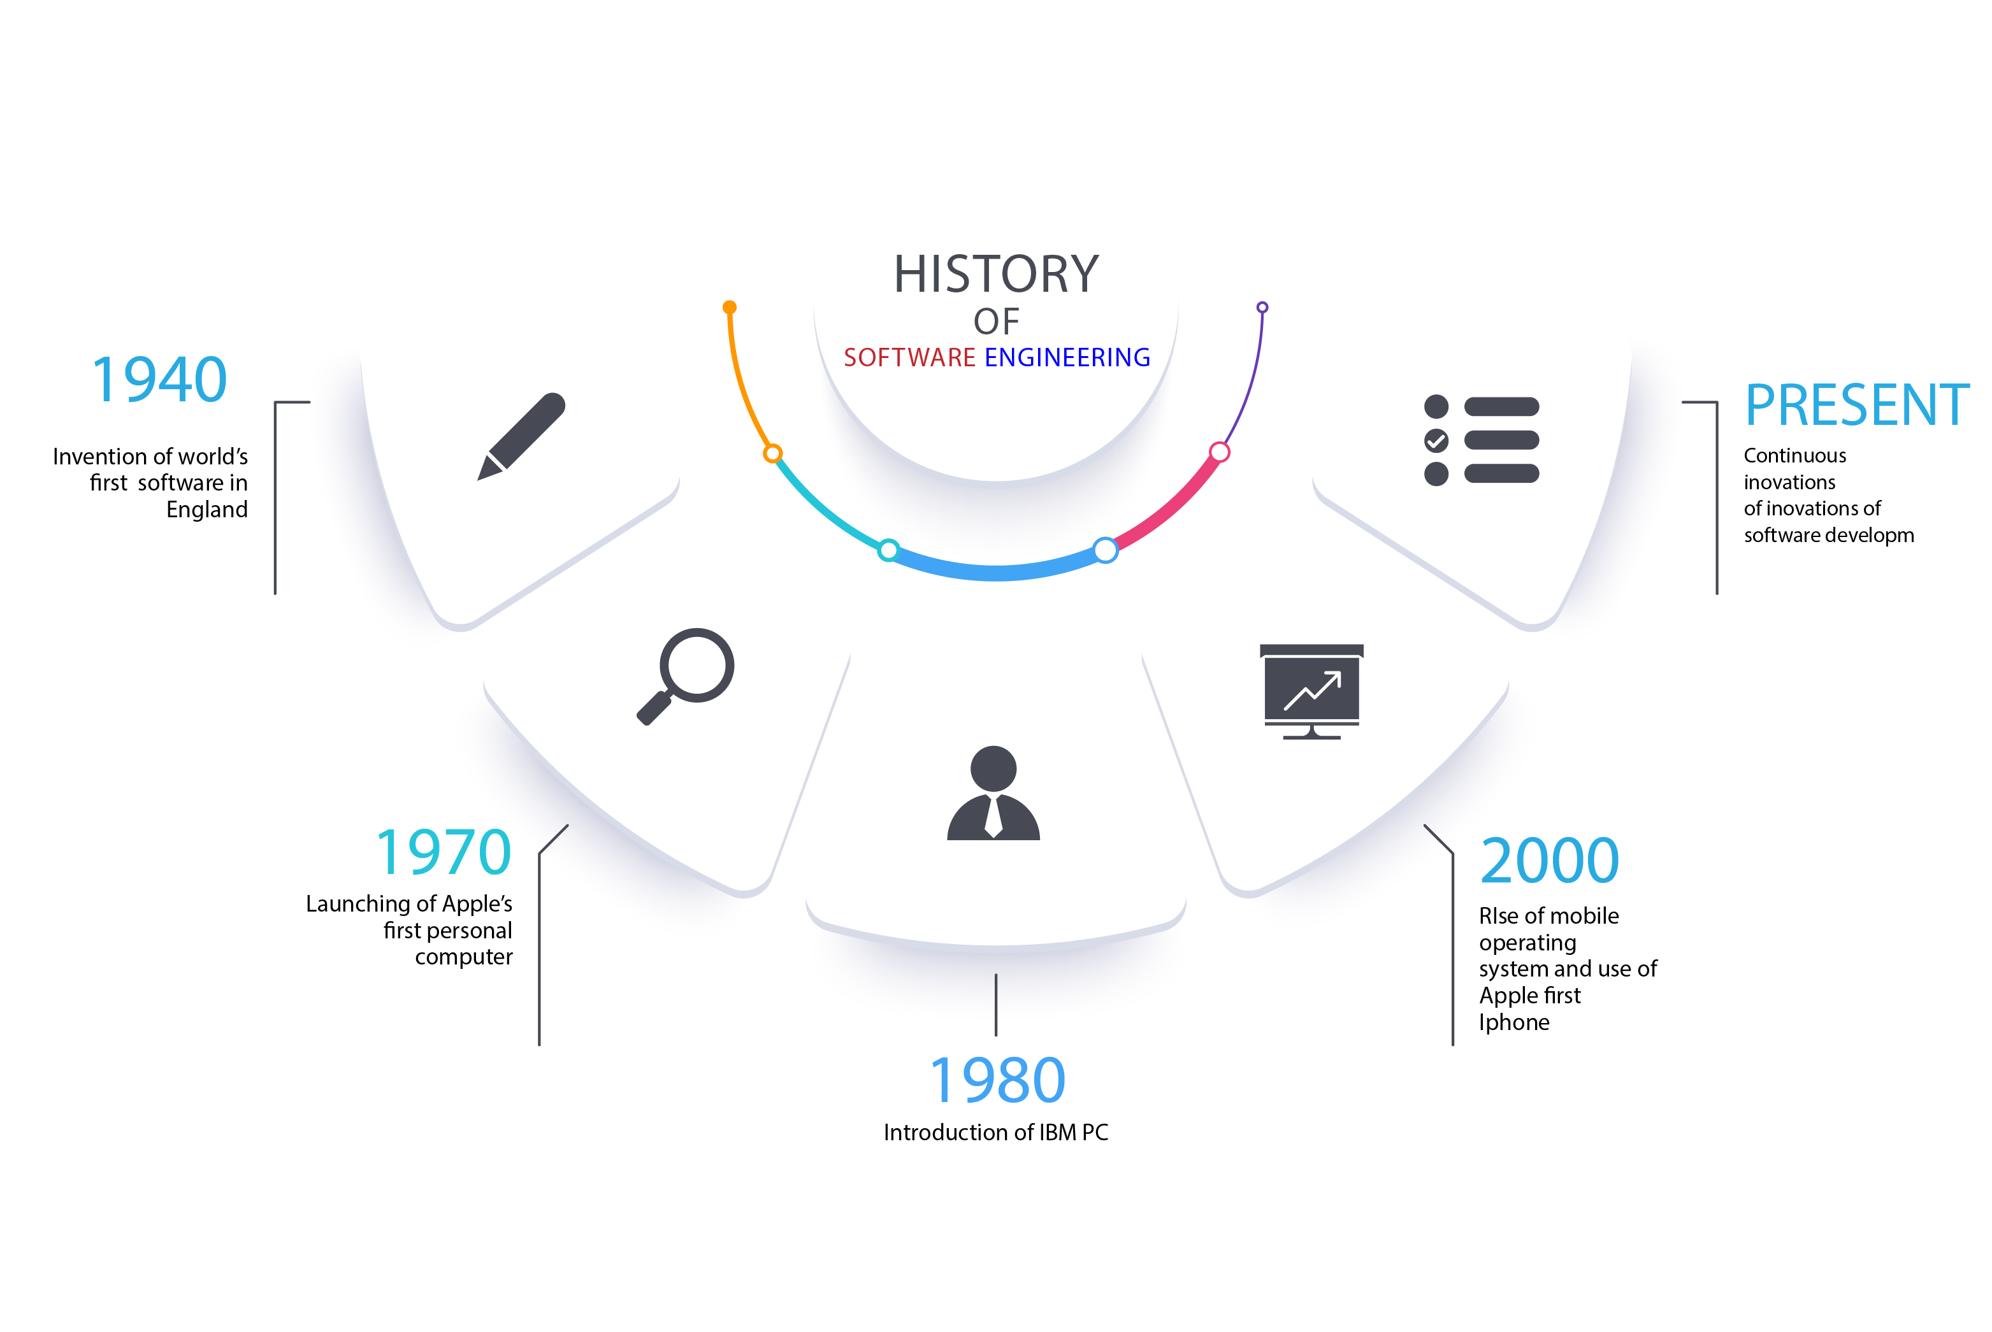
HISTORY

Slide 4
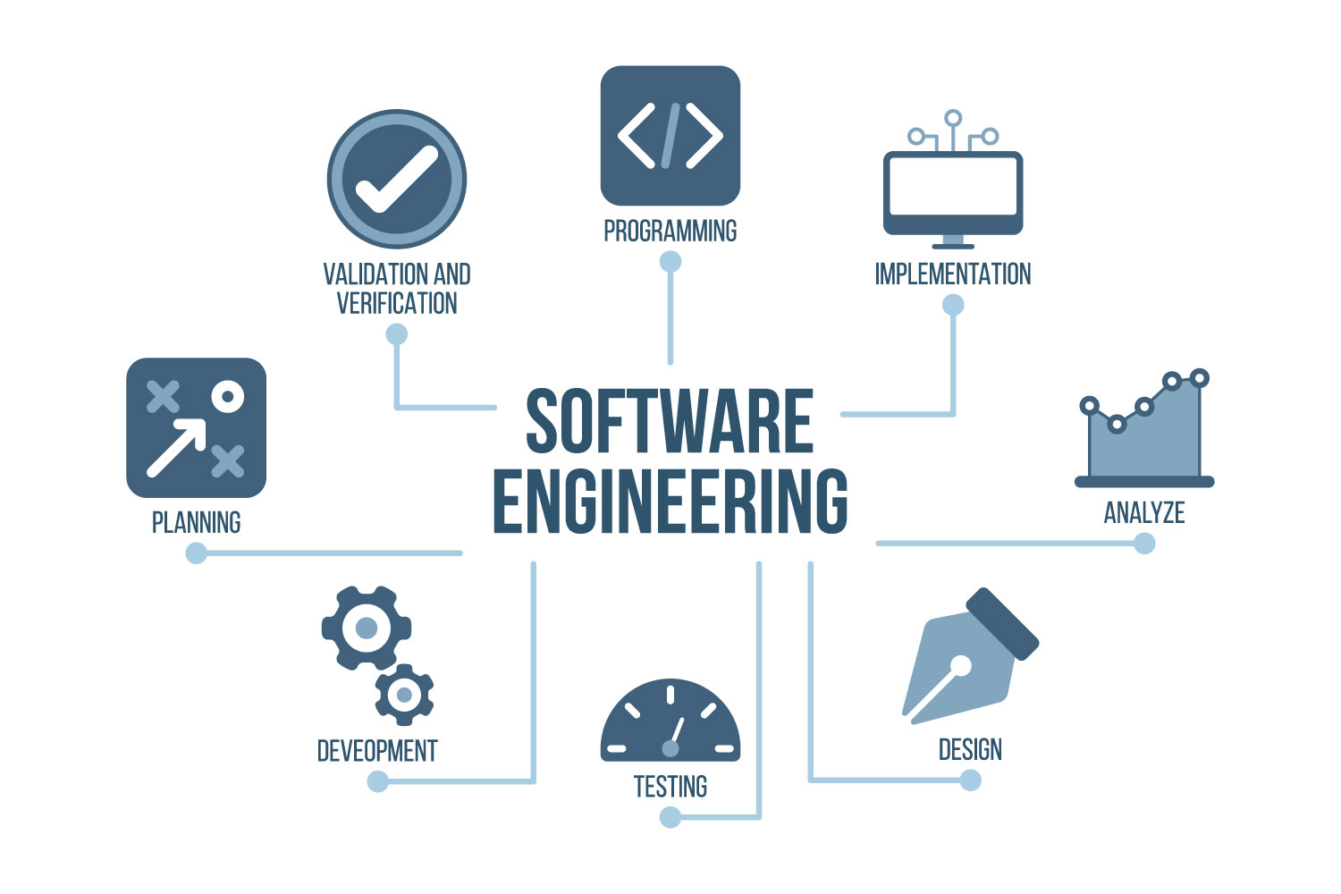
HOW IT WORKS

Slide 5
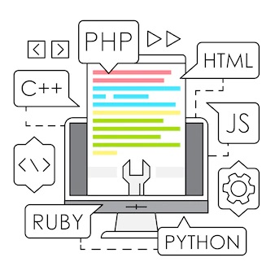
SOFTWARE ENGINEERING THE IMPORTANCE
Reduces complexity
To minimize software cost
To decrease time
Reliable software

Slide 6

SOFTWARE ENGINEERING AS A CAREER
Front-End Engineer
Back-End Engineer
Full Stack Engineer
Software Engineer in Test (QA Engineer)
DevOps Engineer
Security Engineer

Slide 7
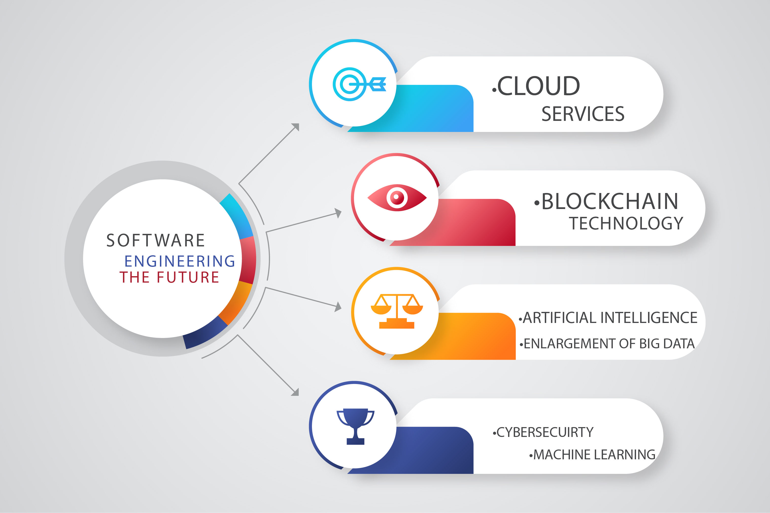
SOFTWARE ENGINEERING THE FUTURE

Slide 8
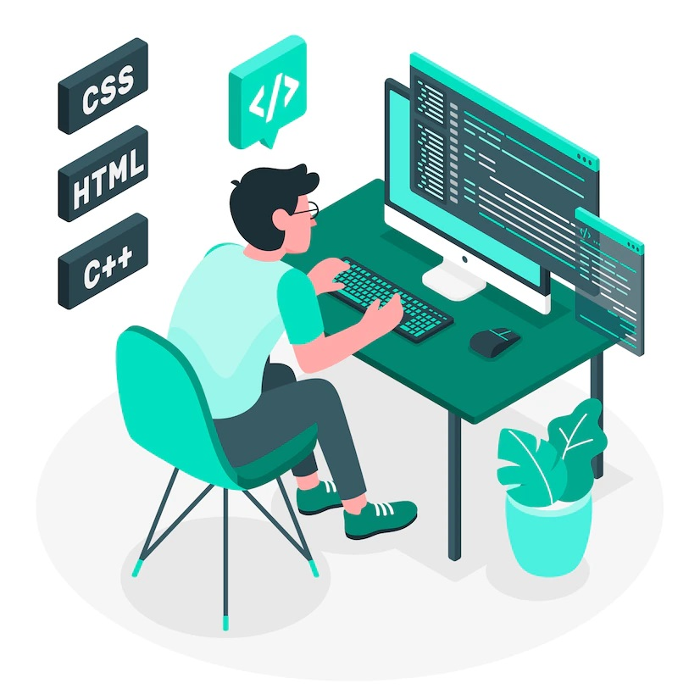
THANK YOU HAVE A NICE DAY

